Slide 1
Run-Time Environment

Slide 2
Run-Time Environments
Programming Languages contain high level structures
Functions
Objects
Exceptions
Scopes
And more..
The physical computer only operates in terms of several primitive operations
Arithmetic
Data Movement
Control Jumps

Slide 3
Run-Time Environments
We need to find a representation of these high level structures using low level structures
A run-time environment(RTE) is a set of data structures maintained at runtime to implement high-level structures of source language
Compiler assumes its target programs are being executed in RTE
Compiler creates and manages it.
IR generators depends on the set up of RTE

Slide 4
Run-Time Environments
Run-Time Environment deals with different issues
The layout and allocation of storage location for the names in the source program
Mechanism to access variables
The linkage between procedures
The mechanisms for passing parameters

Slide 5
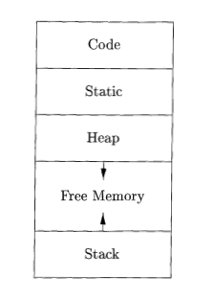
Storage Organization
The executing target program runs in its own logical address space
The operating system maps this to physical address space
Typical Subdivision of memory into code and data areas

Slide 6
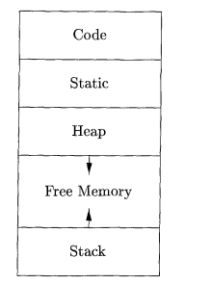
Storage Organization
Generated executable code, size is fixed
Program data objects, sizes are known at compile time
The heap is used to manage long-lived data, generated by the programmer by allocating and deallocating memory
The stack is used to store data structures called activation records that get generated during procedure calls.

Slide 7
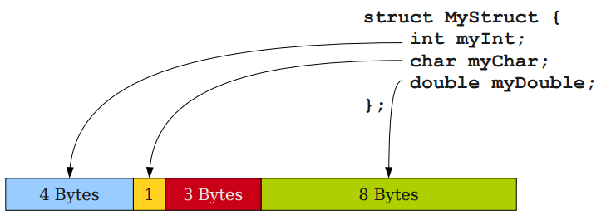
Run-Time Environments
Storage layout is influenced by addressing constraints of target machine
Elementary data types can be stored in an integral number of bytes
Aggregate data types should take space large enough to hold all components
Padding: Unused place due to alignment

Slide 8
Static vs Dynamic Storage Allocation
Static: Can be determined at compile time
Code segment
Static Data segment
Dynamic : Can be decided only while the program is running
Stack Storage
Heap Storage
Static
Dynamic

Slide 9
Stack Allocation
Stack is used for procedures, functions, methods as part of their run time memory
Each time a procedure is called –
Space for its local variable is pushed onto stack
At return time that space is popped off.
Machine Status is saved
Pass parameters and return values
An activation record is a data structure that holds all these information

Slide 10
Nesting of Procedure
If an activation of procedure p calls procedure q then
The activation of q must end before activation of p can end
There are three common cases:
Activation of q terminates normally
Activation of q aborts
Activation of q terminates because of exceptions that q cannot handle
p( )
{
…..
q( );
…..
}

Slide 11
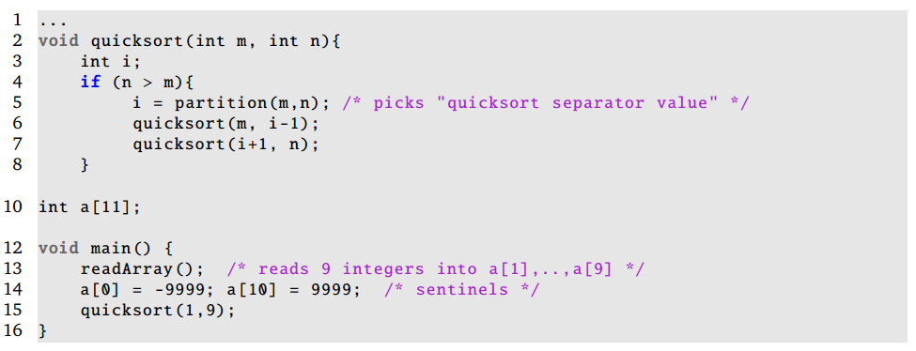
Nested Procedure Call
Procedure Call inside of another procedure
Like nested loop

Slide 12
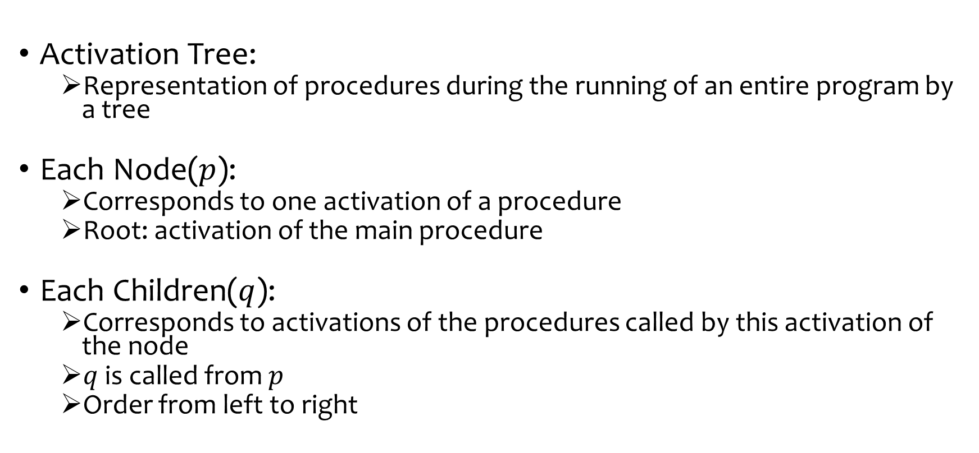
Representing Procedure Call
Activation Tree:
Representation of procedures during the running of an entire program by a tree
Each Node($p$):
Corresponds to one activation of a procedure
Root: activation of the main procedure
Each Children($q$):
Corresponds to activations of the procedures called by this activation of the node
$q$ is called from $p$
Order from left to right

Slide 13
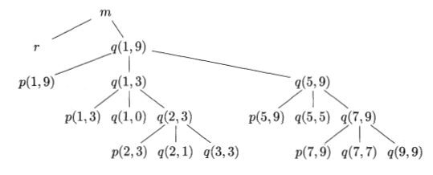
Activation Tree
Activation tree of quicksort during an execution of quicksort

Slide 14
Activation Tree
Several useful relationships between activation tree and behavior of the program
Sequence of procedure calls corresponds to preorder traversal of the activation tree
Return sequence corresponds to post order traversal
At any node N the live activations are those that corresponds to N and its ancestor

Slide 15
Activation Tree
Already Processed
Alive
Yet to call
Activation tree of quicksort during an execution of quicksort

Slide 16
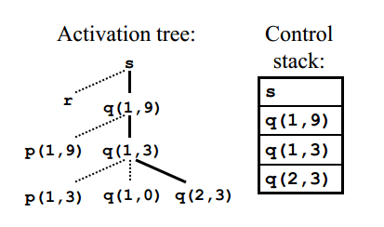
Control Stack
Control Stack: Procedure calls and returns are managed by a run time stack
Each live activation has an activation record (AR) or stack frame on the control stack
Root of the activation tree (main proc) at the bottom
Sequence of AR in the stack corresponds to path in the AT

Slide 17
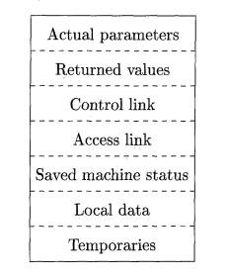
Activation Records (AR)
Contents of AR depends on language.
Contents may be
Temporary: to evaluate expressions
Local Data: belonging to the procedures
Saved machine status:
Access link: to locate data found in another activation
Control link: pointing to AR of the caller
Returned Value:
Actual Parameters: used by the calling procedure
A general Activation Record

Slide 18
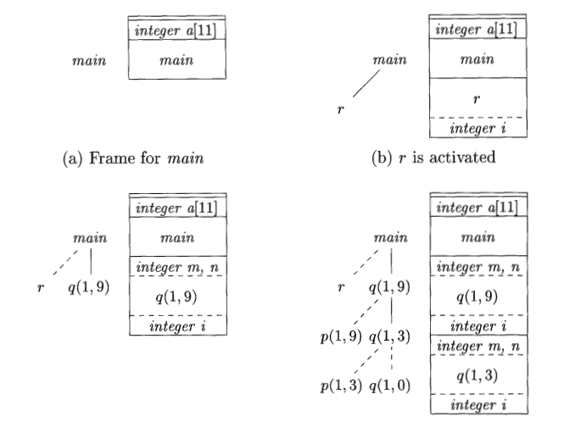
Activation Records (AR)

Slide 19
Calling and Return Sequence
Calling Sequence
Code that allocates activation record on the stack.
Return Sequence
Code that restore the state of the machine before calling
May be divided between caller and the callee

Slide 20
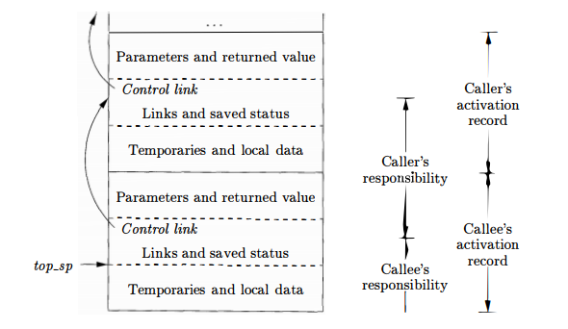
Calling and Return Sequence

Slide 21
Reference
Compilers: Principles, Techniques, & Tools, by
Alfred B. Aho, Monica S. Lam, Ravi Sethi, Jeffrey D. Ullman
Chapter 7
7.1
7.2.1-7.2.3

Slide 22
Thank You!

